Slide 1
IBM HR Analytics | Employee Attrition
Understanding attrition, rewards and retention risk
Descriptive analytics • Employee experience • Predictive modelling
Capstone presentation • Based on latest Power BI dashboard
1

Slide 2
Executive Summary
1,465
237
16.18%
Employees
Employees left
Attrition rate
Main patterns
Overtime • Lower satisfaction • Early tenure • Career progression
2

Slide 3
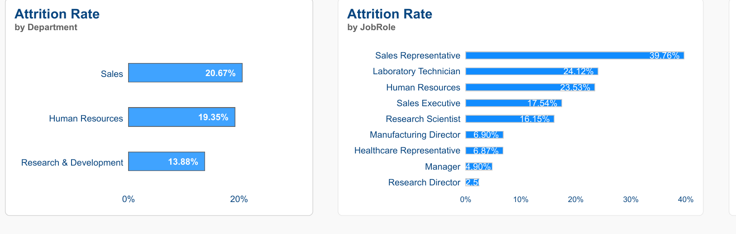
Where Is Attrition Concentrated?
Sales has the highest department attrition rate: 20.67%.
3

Slide 4
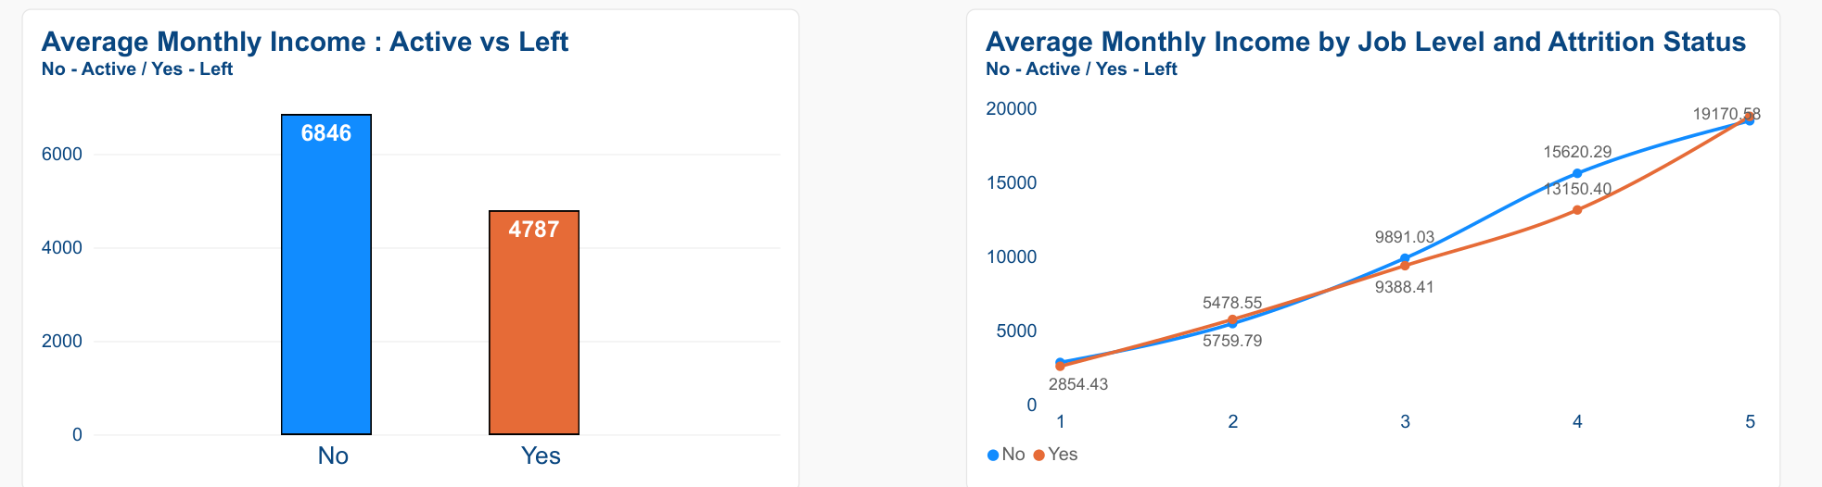
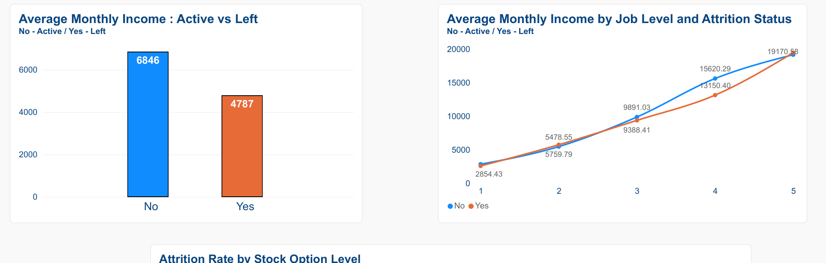
Compensation: Active vs Departed Employees
Average monthly income: active 6,846 vs departed 4,787 (dataset units).
4

Slide 5
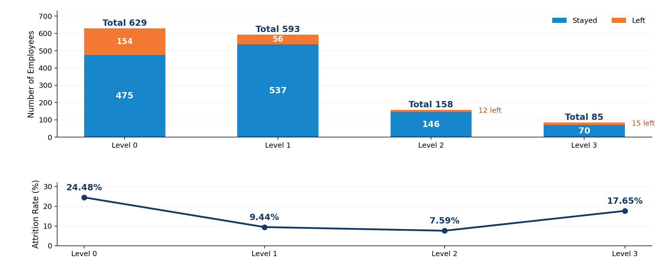
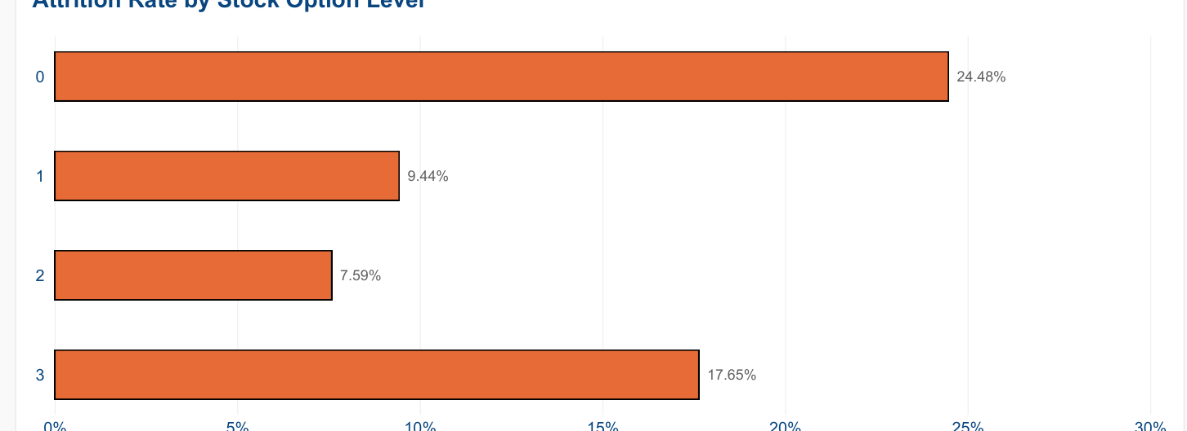
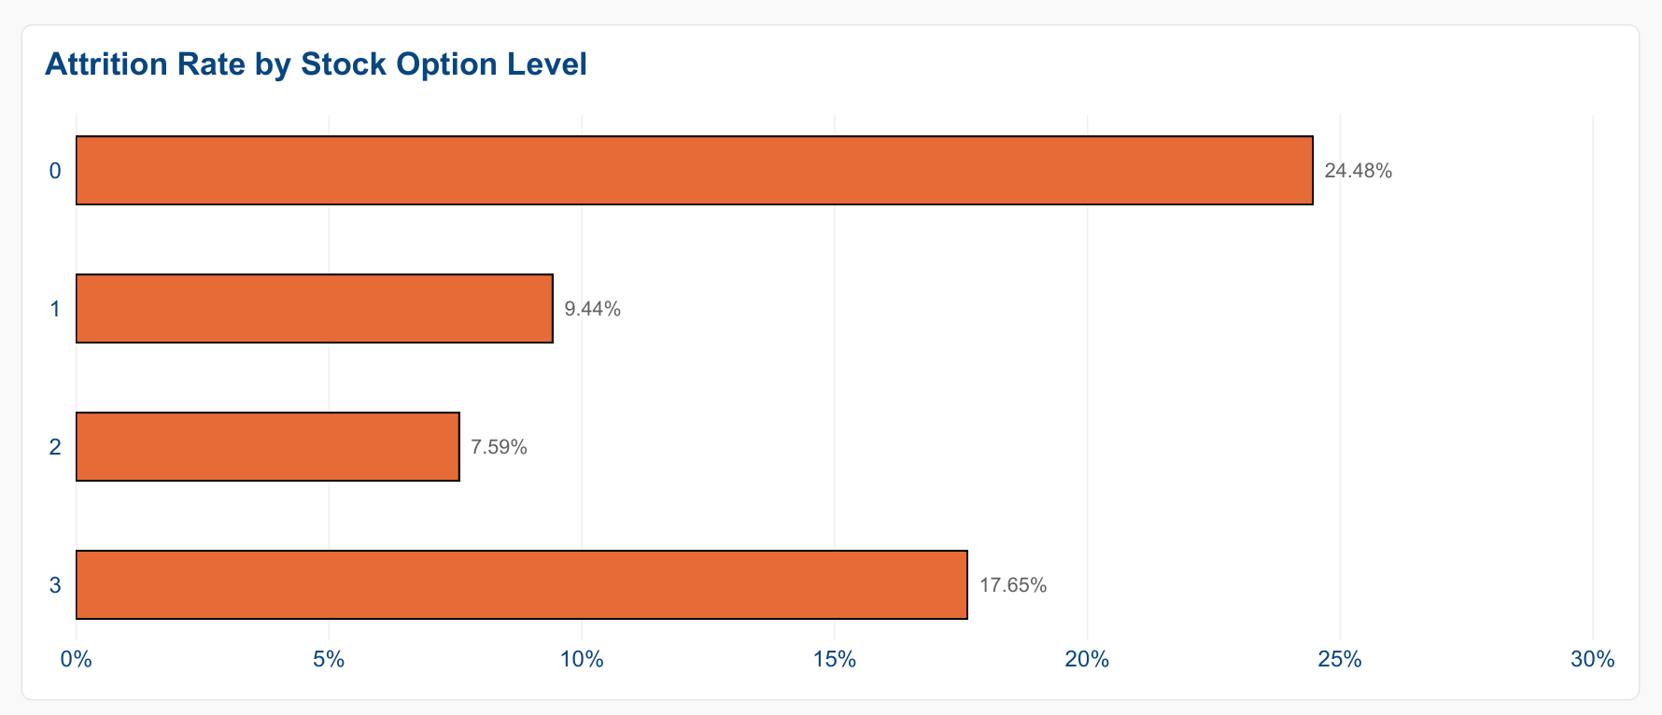
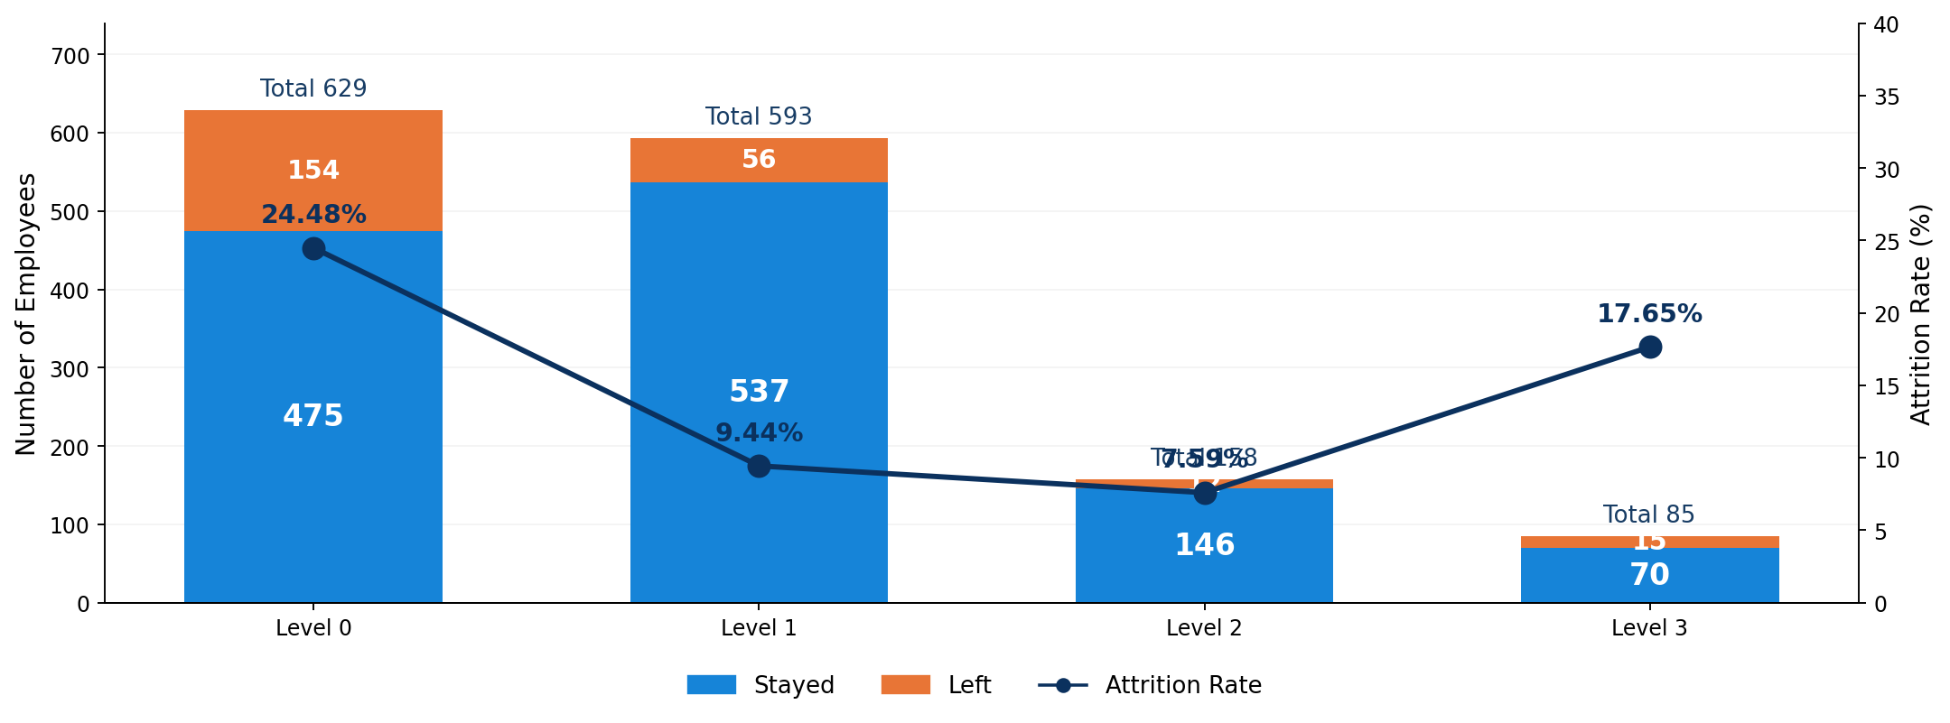
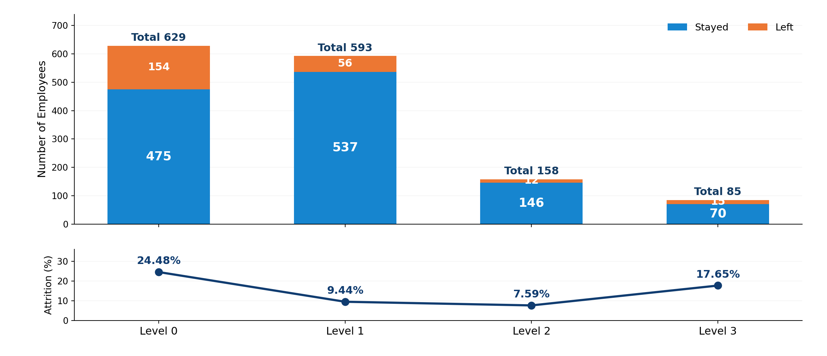
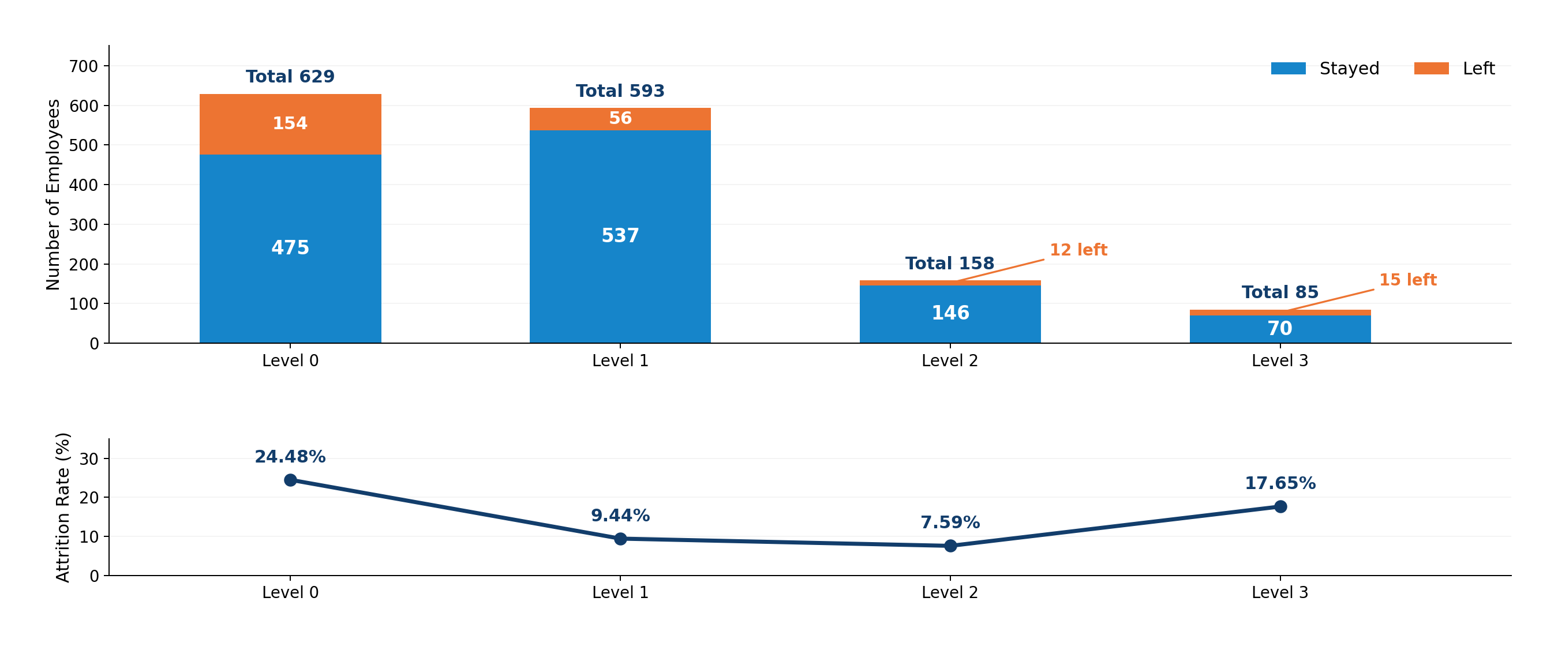
Rewards: Stock Options and Attrition
Level 0: 629 employees (475 stayed; 154 left), with 24.48% attrition.
5

Slide 6
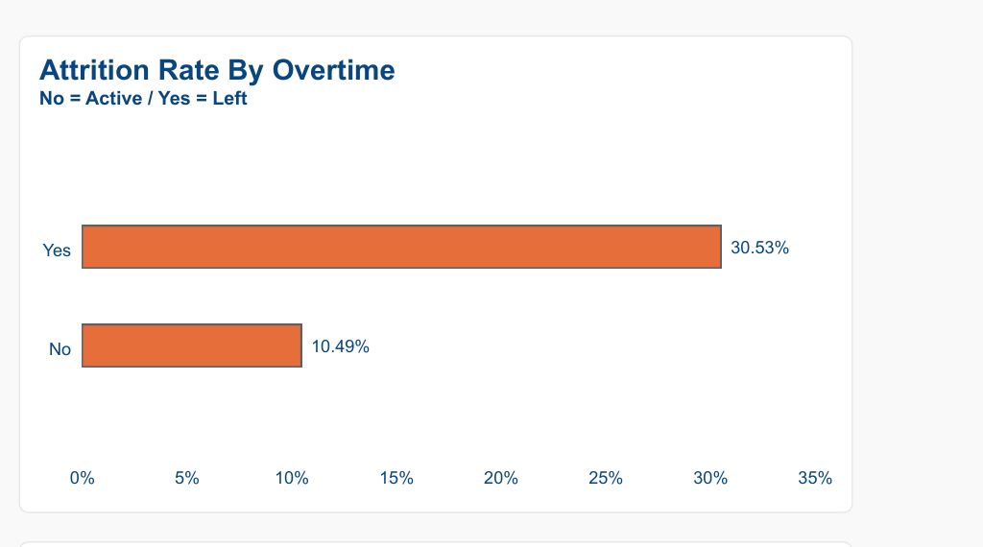
Overtime Is a Major Retention Risk
Attrition: overtime 30.53% vs no overtime 10.49%.
6

Slide 7
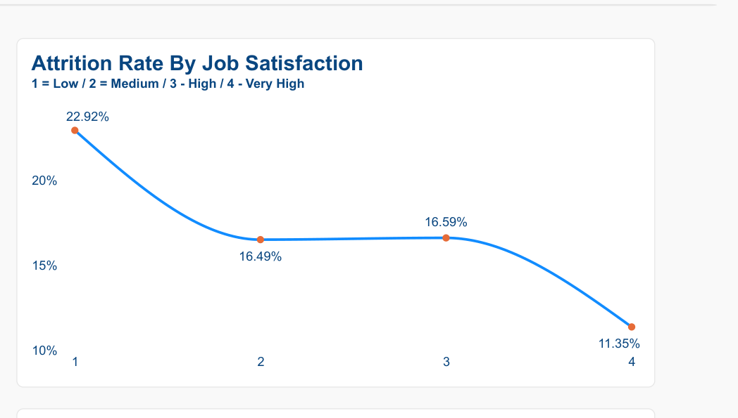
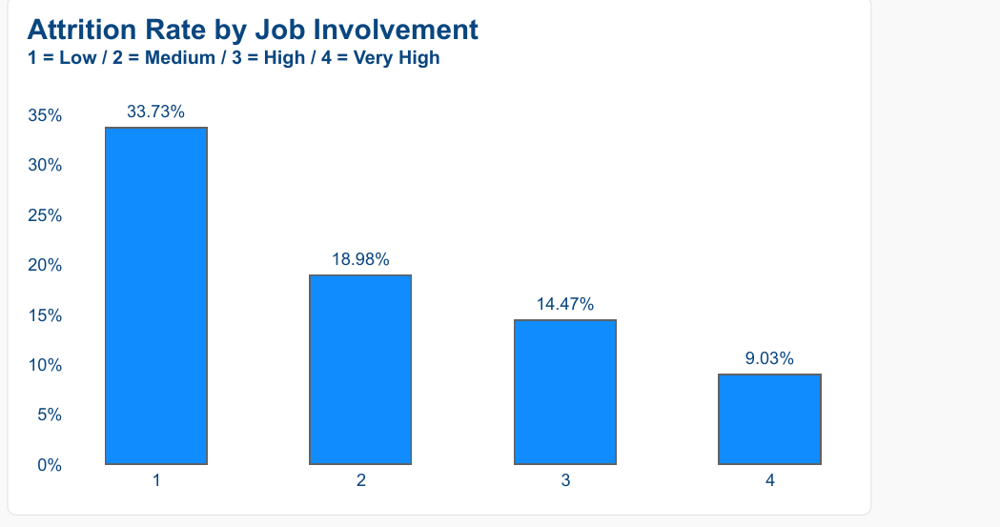
Employee Experience Matters
Low job satisfaction and low job involvement coincide with higher attrition.
7

Slide 8
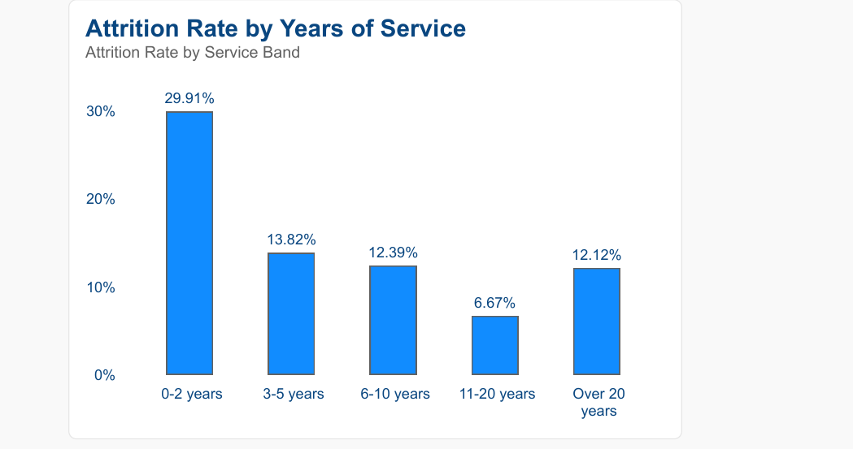
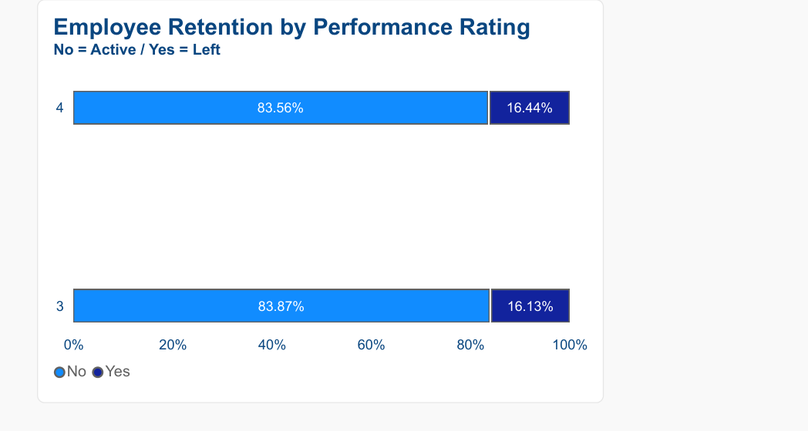
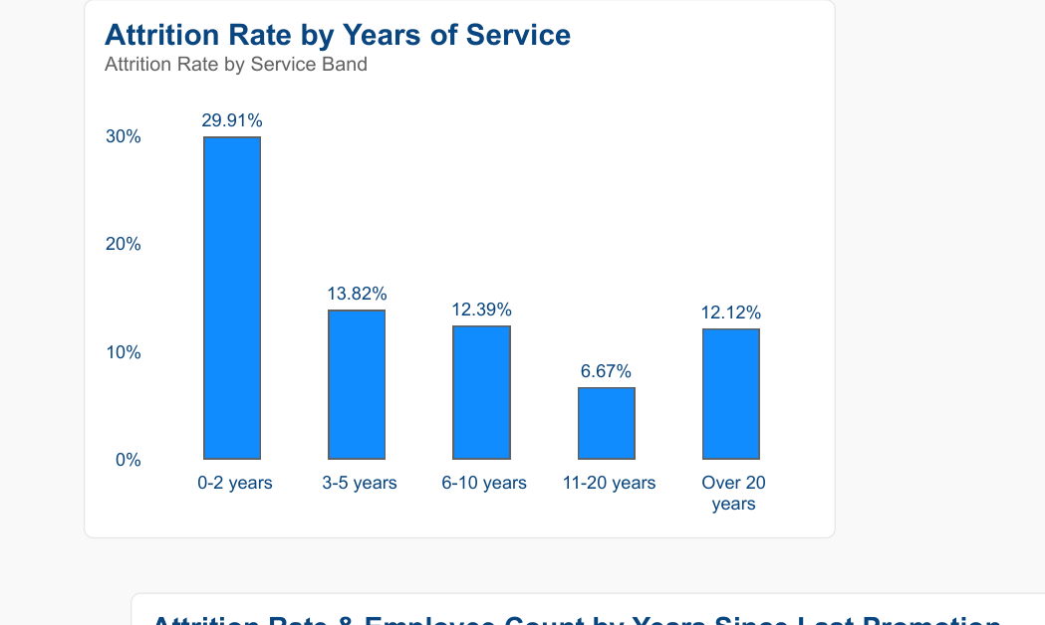
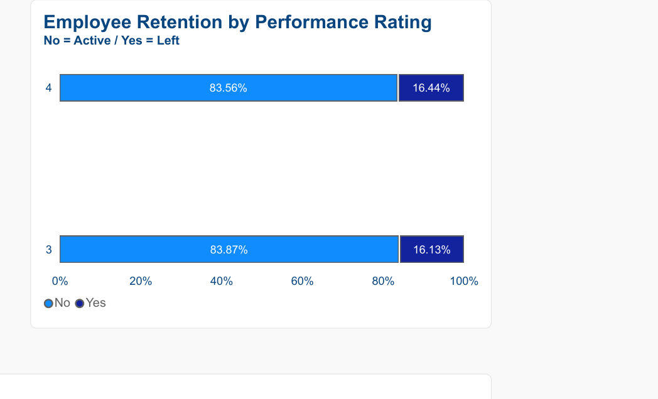
Early-Tenure Attrition and Performance
0–2 years: 29.91% attrition; rating 4: 16.44% attrition.
8

Slide 9
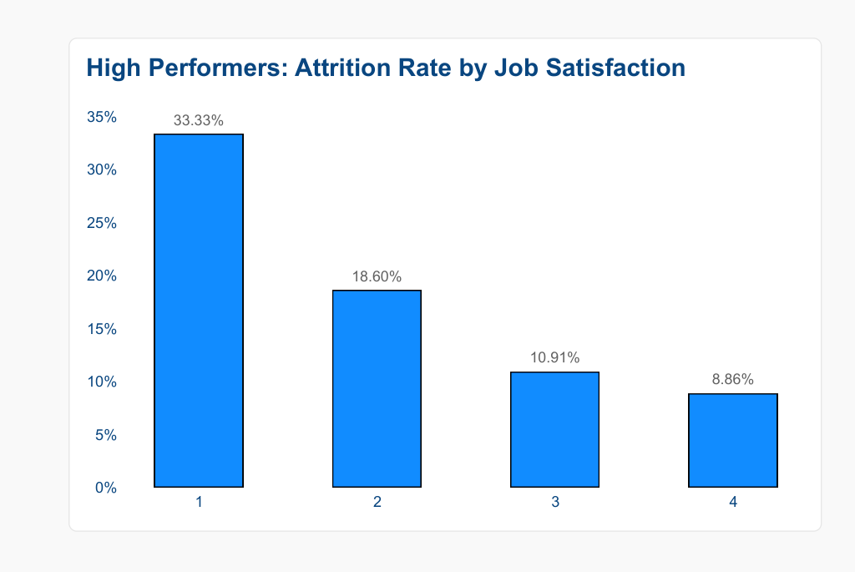
High Performers: Job Satisfaction
Among rating-4 employees, attrition falls from 33.33% to 8.86% as satisfaction rises.
9

Slide 10
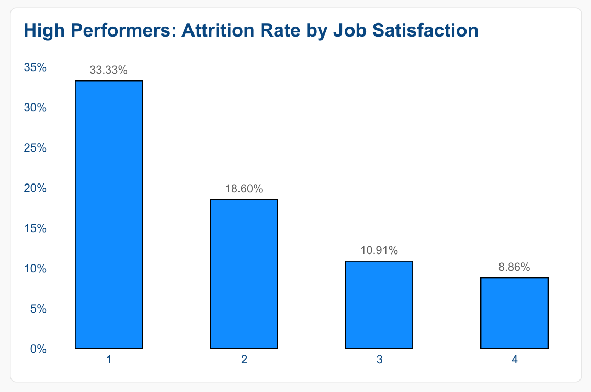
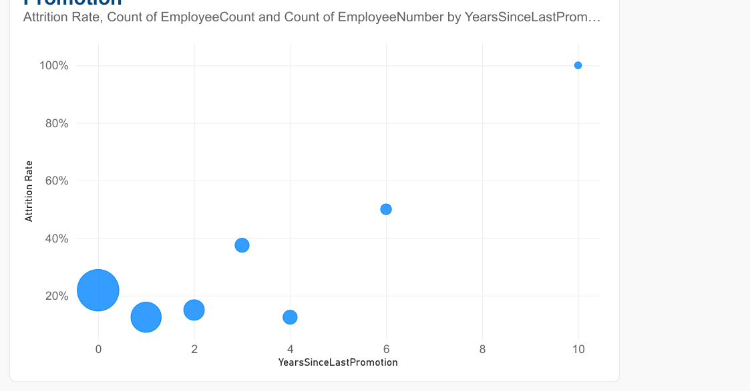
High Performers: Satisfaction and Retention Risk
Among high performers, attrition falls from 33.33% to 8.86% as satisfaction rises.
10

Slide 11
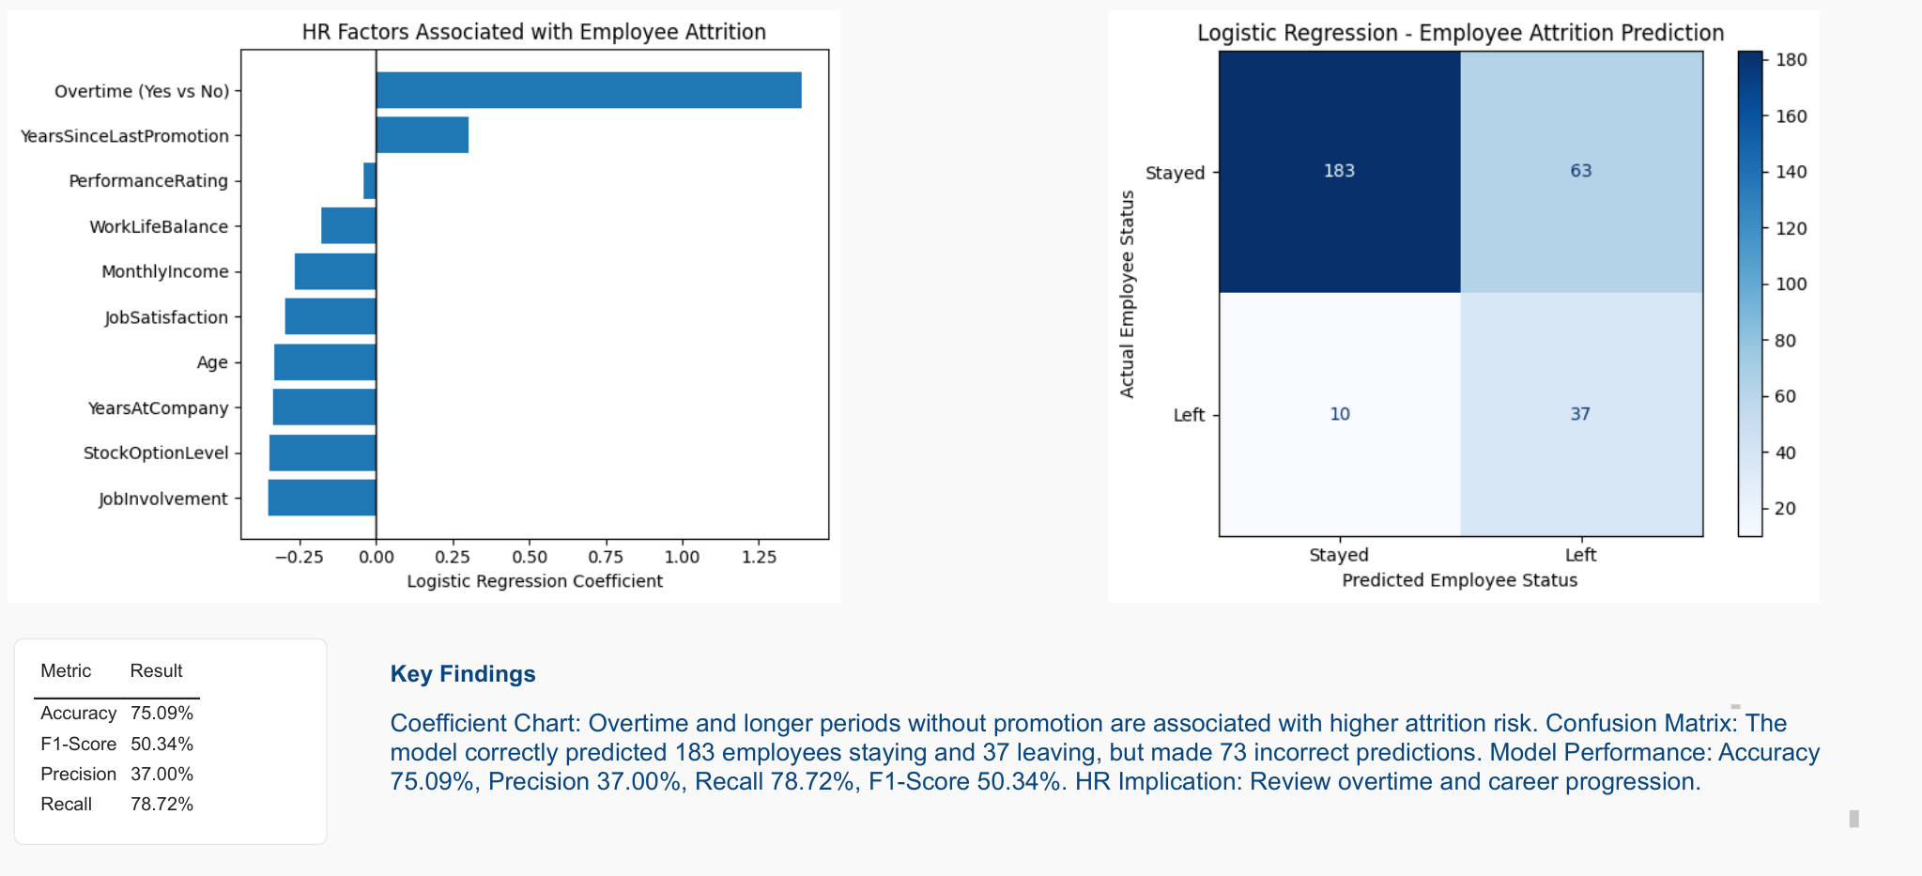
Predictive Analytics: Logistic Regression
Accuracy 75.09%; recall 78.72%; precision 37.00%.
11

Slide 12
Recommended HR Actions
01
Review overtime workload and staffing
02
Prioritise retention support in the first two years
03
Retain high performers through career development and job satisfaction
04
Monitor attrition trends and evaluate retention actions
Outcome: targeted, measurable retention interventions
12

